Slide 1
Infected Blood Inquiry Finance Report
Financial Year April 2018 to March 2019

Slide 2
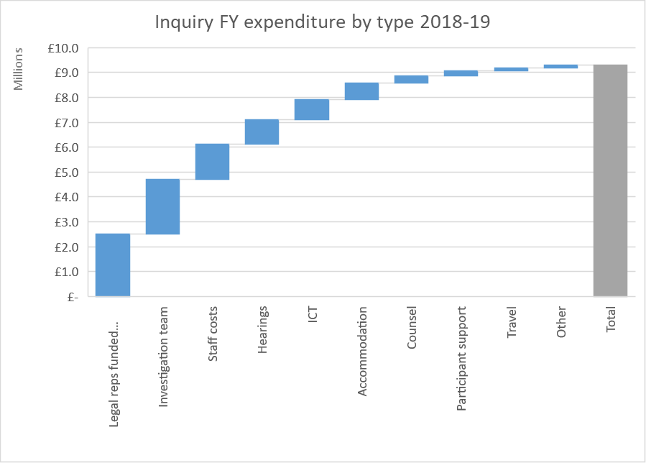
Inquiry 2018-19 expenditure
The Inquiry spent £9.288m for the financial year to March 2019 (as at date of publication).
Expenditure for the financial year can be broken down as follows:

Slide 3
Inquiry 2018-19 expenditure (cont)
Areas of spend can be explained as follows:
Legal representatives funded through the Inquiry includes all firms awarded costs to represent core participants of the Inquiry.
The investigation team consists of paralegals, investigative lawyers and investigators working on the Inquiry.
Staff costs include Inquiry staff and secondees from the Government Legal Department and other government departments.
Hearings costs are the fit out costs and rent for the hearing space in Fleetbank House and Church House costs. It also includes audio visual costs for the preliminary hearings.
ICT costs are the costs for the Inquiry’s document management system, scanning and ICT.
Accommodation costs are the rents and setup costs for the Inquiry’s office spaces.
Counsel costs refers to barristers working on the Inquiry.
Participant costs are the costs of local meetings for people infected and affected, participant travel costs and psychological support.
Travel consists of staff and investigation team travel costs.
Other costs include intermediaries, office and other miscellaneous costs incurred.

